Slide 1

Sprint 4 - Presentation
By Nathan, Sahmi, and Camryn

Slide 2
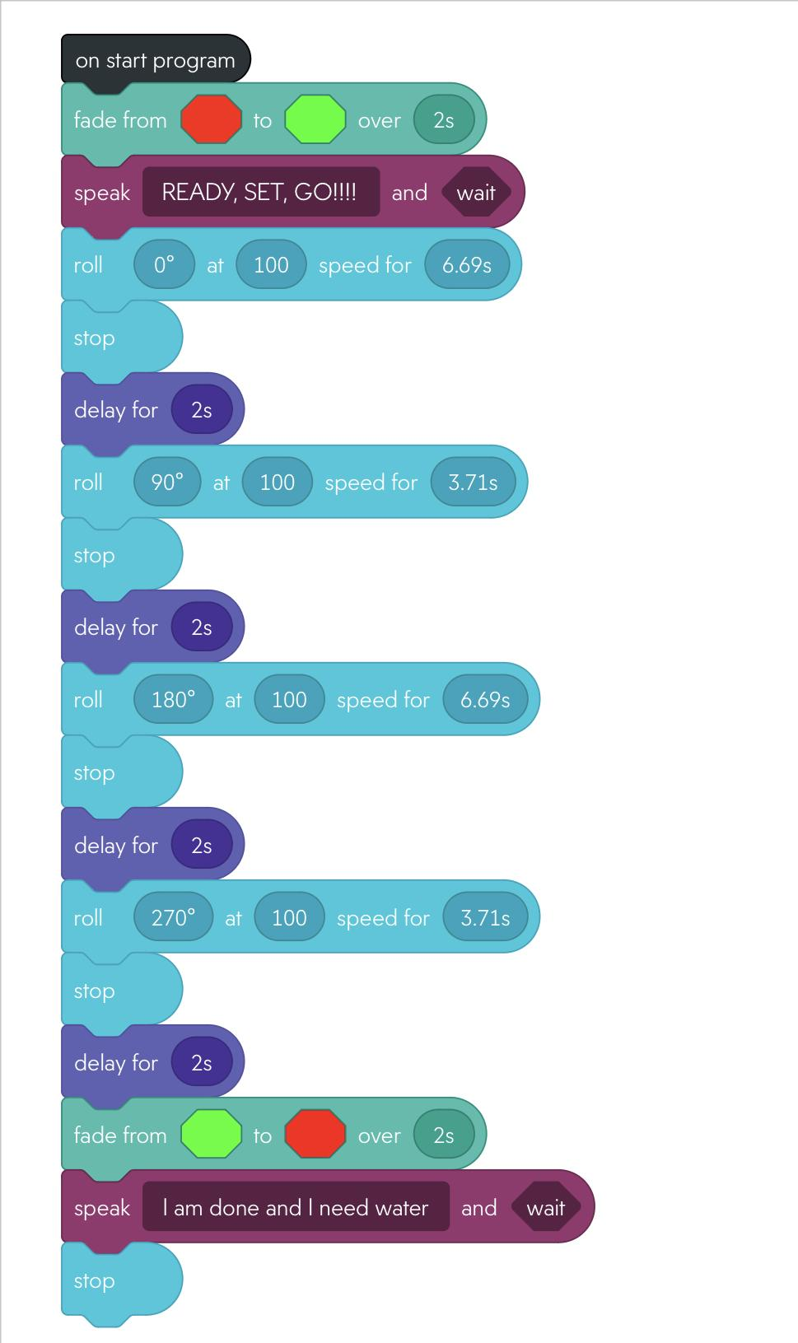
Block Code Endurance

Slide 3
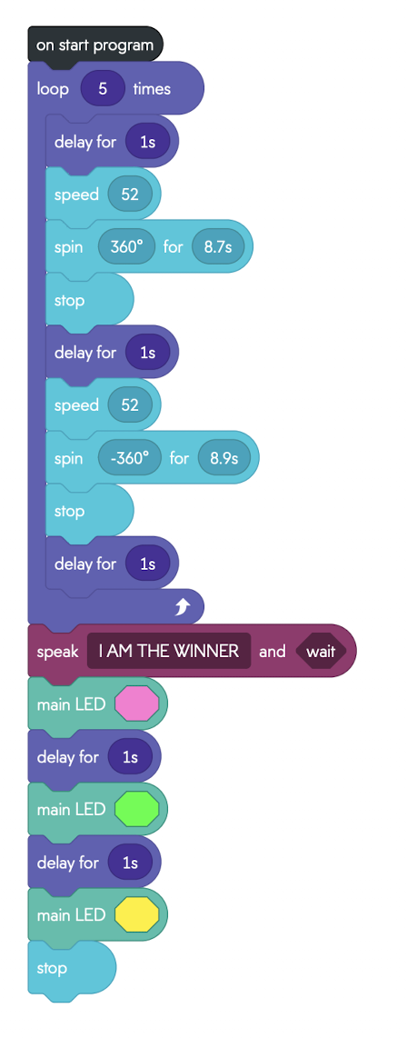
Block Code Accuracy

Slide 4
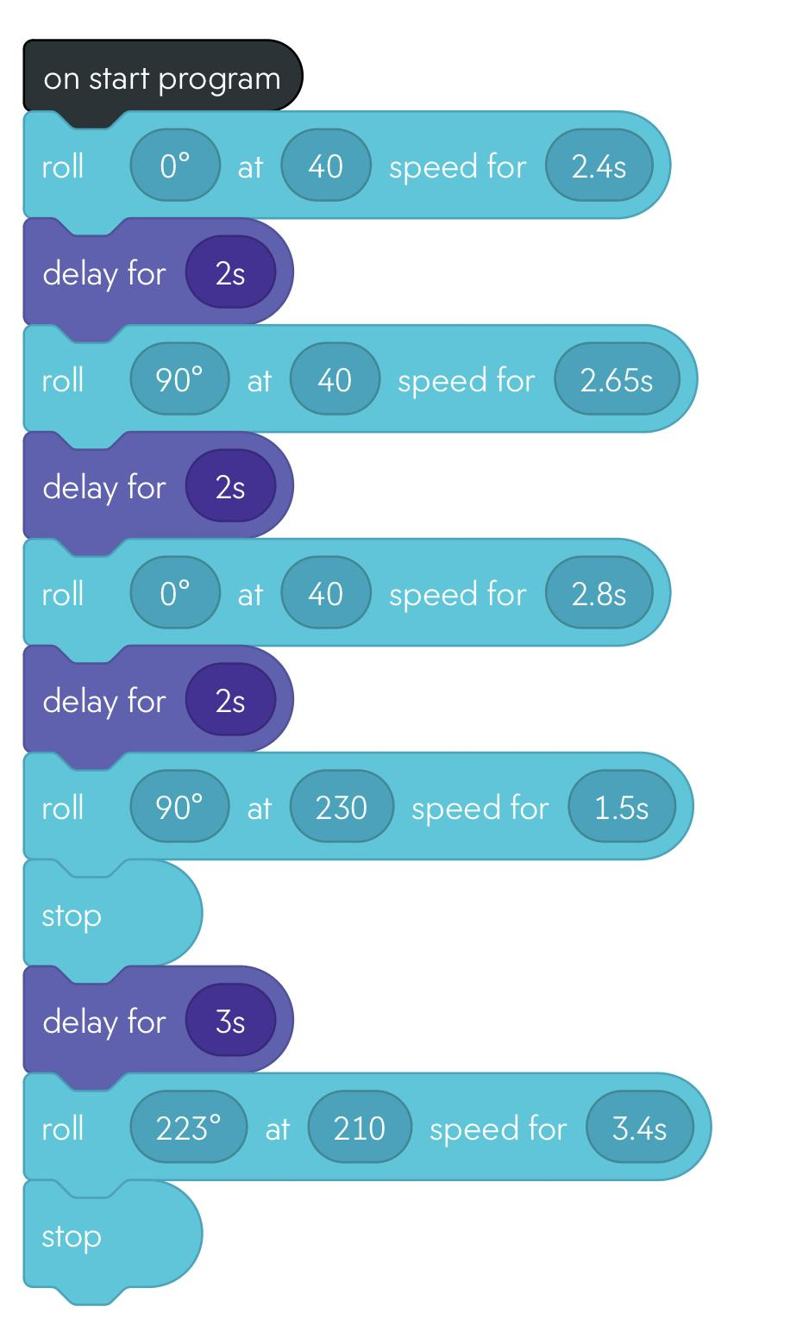
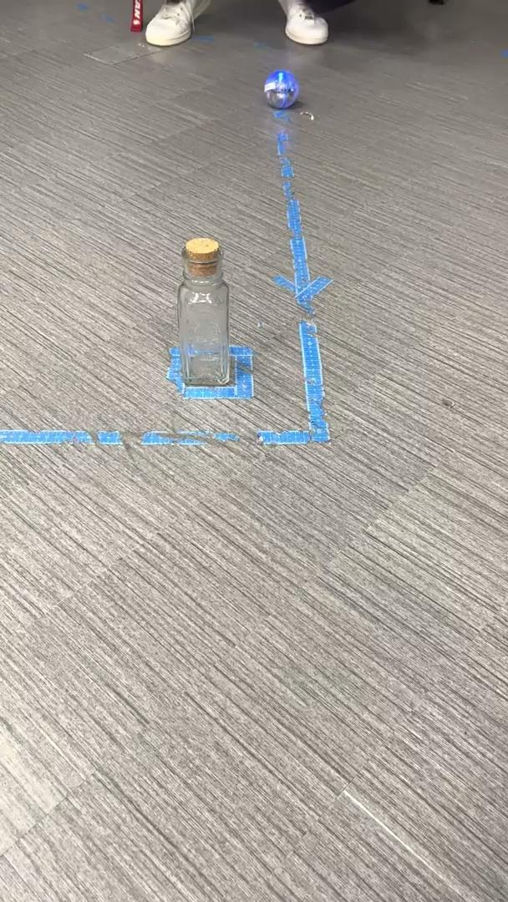
Block Code Agility

Slide 5
Roles of each team member:
Sahmi
Software Design
Creates code, takes measurements, creates algorithms, and has the lead on making sure the robot follows the correct procedures.
Nathan
System Design
Provide all details concerning the technical design, staffing, coding, and testing the system
Camryn
Project Manager
Receives and gives instructions, suggests changes that should be made to better the tests. Filled out Gantt chart and project summary.

Slide 6
Challenges we faced:
Having the robot stop directly where it needed to be
Keeping up consistency: sometimes the robot would move correctly the first try but mess up the second
Having open time to meet up and work on the project

Slide 7
What we have learned about Software Engineering:
It’s important to work as a team
The coding will not be close to perfect on the first few tests
It takes a lot of tests and changes in order for code to be anywhere near perfect

Slide 8
What we would do differently:
Change the floor surface
Find more chances to meet up and work

